Slide 1
The Power of External Market Forces
Technological
Political
Economic
Legal
Environmental
Social

Slide 2


POLITICAL
Government type and stability
Freedom of the press, rule of law and levels of bureaucracy and corruption
Regulation and de-regulation trends
Social and employment legislation
Tax policy, and trade and tariff controls
Environmental and consumer-protection legislation
Likely changes in the political environment

Slide 3
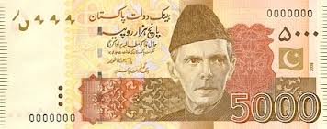
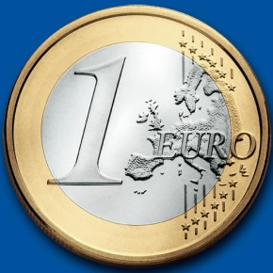
Economic
Stage of a business cycle
Current and projected economic growth, inflation and interest rates
Unemployment and supply of labor
Labor costs
Levels of disposable income and
income distribution
Impact of globalization
Likely impact of technological or other changes on the economy
Likely changes in the economic environment

Slide 4

Social
Cultural aspects, health consciousness, population growth rate, age distribution,
Organizational culture, attitudes to
work, management style, staff attitudes
Education, occupations, earning capacity, living standards
Ethical issues, diversity, immigration/emigration, ethnic/religious factors
Media views, law changes affecting social factors, trends, advertisements, publicity
Demographics: age, gender, race, family size

Slide 5


Technological
Research Funding, Technology legislation, new discoveries
Information technology, internet, global and local communications
Technology access, licensing, patents, potential innovation, replacement technology/solutions,
Transportation, energy uses/sources/fuels, waste removal/recycling

Slide 6
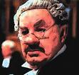
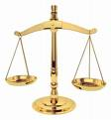
Legal
current home market legislation, future legislation
international legislation
regulatory bodies and processes
environmental regulations, employment law, consumer protection
industry-specific regulations, competitive regulations

Slide 7




Environmental
How people’s perception and reaction to environmental issues can affect a business.

Slide 8
Step 4: Identify Key Success Factors
Key success factors: controllable variables that determine the relative success of market participants.
The keys to unlocking the secrets of competing successfully in a particular market segment.

Slide 9
Step 4: Identify Key Success Factors
Common Types of KSFs
Technology
Expertise in Research
Manufacturing Related
Ability to Achieve Economies of Scale
Quality Control
High Utilization of Fixed Assets
High Labor Productivity
Distribution Related
Strong Network of Wholesale Distributors/Dealers
Strong Direct Sales Capabilities
Ability to Secure Favorable Display Space on Retailers Shelves

Slide 10
Step 4: Identify Key Success Factors
Common Types of KSFs
Marketing
Brand Name
Fast, Accurate Technical Assistance
Accurate Filling of Buyer’s Orders
Customer Guarantees
Skills & Capability
Talented Workforce
Product Innovation Capabilities
Short Delivery time Capabilities
Strong E Commerce Capabilities
Other
Convenient Location

Slide 11
Step 5: Analyze Competitors
NFIB study: Small business owners believe they operate in a highly competitive environment and the level of competition is increasing.
Yet, 97 percent of all U.S. businesses do not systematically track the progress of their key competitors.

Slide 12

Step 5: Analyze Competitors
Analyzing key competitors allows an entrepreneur to:
Avoid surprises from existing competitors’ new strategies and tactics.
Identify potential new competitors and the threats they pose.
Improve reaction time to competitors’ actions.
Anticipate rivals’ next strategic moves.

Slide 13

Step 5: Analyze Competitors
Techniques do not require unethical behavior:
Monitor industry and trade publications.
Talk to customers and suppliers.
Regularly debrief employees, especially sales representatives and purchasing agents.
Attend trade shows and conferences and study competitors’ sales literature.

Slide 14

Step 5: Analyze Competitors
Techniques do not require unethical behavior:
Watch for employment ads from competitors to get an idea about their plans for the future.
Conduct patent searches for patents competitors have filed.
Learn about the kinds of equipment and raw materials competitors are importing.
Buy competitors’ products and “benchmark”
them.

Slide 15
Step 5: Analyze Competitors
Techniques do not require unethical behavior:
Get competitors’ credit reports.
Check out the reports publicly held competitors must file with the SEC.
Use the World Wide Web to learn more about competitors.
Visit competing businesses to observe their operations.

Slide 16
Knowledge Management
The practice of gathering, organizing, and disseminating the collective wisdom and experience of a company’s employees for the purpose of strengthening its competitive position.
Knowledge management involves:
Taking inventory of the special knowledge the people in the company possess.
Organizing that knowledge and disseminating it to those who need it.

Slide 17
Step 6: Create Company Goals and Objectives
Goals - broad, long-range attributes to be accomplished.
Objectives - more detailed, specific targets of performance that are S.M.A.R.T.
Specific
Measurable
Attainable
Relevant
Timely

Slide 18
Step 6: Create Company Goals and Objectives
SMART GOAL EXAMPLE
Broad Goal: I want to grow my business.
Specific: I will acquire twenty new clients for my consulting business.
Measurable: I will measure my progress by how many new clients I bring on, while maintaining my current client base.
Attainable: I will ask current clients for referrals, launch a social media marketing campaign and network with local businesses.
Relevant: Adding additional clients to my business will allow me to grow my business and increase my revenue.
Time-Based: I will have twenty new clients within six months.

Slide 19
Step 7: Formulate Strategies
Strategy - a road map of the actions an entrepreneur draws up to achieve a company’s mission, goals, and objectives. It is the company’s game plan for gaining a competitive advantage.
Three basic strategies:
Cost leadership
Differentiation
Strategy?
Focus

Slide 20
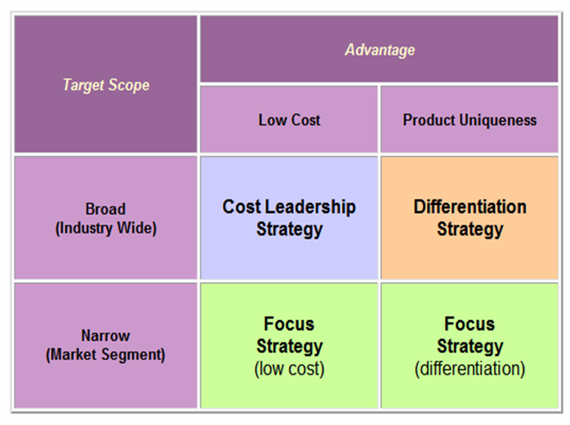
Three Generic Strategy Options

Slide 21
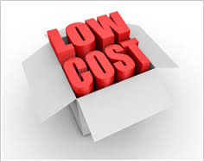

Cost Leadership
Goal: to be the low-cost producer in the industry (or market segment).
Low-cost leaders have an advantage in reaching buyers who buy on the basis of price, and they have the power to set the industry’s price floor.
Works well when:
Buyers are sensitive to price changes.
Competing firms sell the same commodity products.
A company can benefit from economies of scale.
Example: JetBlue Airlines

Slide 22

Differentiation
Company seeks to build customer loyalty by positioning its goods or services in a unique or different fashion.
Idea is to be special at something customers value.
Key: Build basis for differentiation on a distinctive competence, something that the small company is uniquely good at doing in comparison to its competitors.
Examples: Outfitters and the Ice Hotel

Slide 23
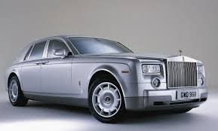

Focus
Company selects one or more customer segments in a market; identifies customers’ special needs, wants, or interests; and then targets them with a product or service designed specifically for them.
Strategy builds on differences among market segments.
Rather than try to serve the total market, the company focuses on serving a niche (or several niches) within that market.
Examples: Rolls Royce

Slide 24
Step 8: Translate Strategies into Action Plans
Survey of senior executives: Companies achieved only 63 percent of the results in their strategic plans.
Create projects by defining:
Purpose
Scope
Contribution
Resource requirements
Timing

Slide 25


Step 9: Establish Accurate Controls
Plan establishes the standards against which actual performance is measured.
Entrepreneur must:
identify and track key performance indicators.
take corrective action.

